Slide 1
Design Society – theDesignExchange.org
Collaboration Meeting
theDesignExhange.org
Oct. 10th, 2018
theDesignExchange is a joint project led by UC Berkeley and M.I.T. working with the international community of design academics and practitioners. We thank our industry collaborators who hosted our workshop series: Autodesk, Frog, Goto Media, DesignMap, and IDEO. This work was partially supported by NSF grant CMMI-1334361.
Notes:
Hi. Everyone. My name is Euiyoung Kim, a postdoc-scholar and lecturer at UC Berkeley. Today I want to talk about ‘applying Design Roadmapping in new product development education, particularly insights we learned from student design teams.

Slide 2
Agenda
tDX overview Methods | Case studies | Collection Skillsets Matrix Discussion
Toolkit for students, teachers, practitioners
Agenda
Human-Centered Design Toolkit for students, teachers, practitioners

Slide 3
theDesignExchange Mission
The world’s largest open-source innovation archive of design methods and case studies.
With over 300 methods to choose from, we help guide your method discovery and selection

Slide 4
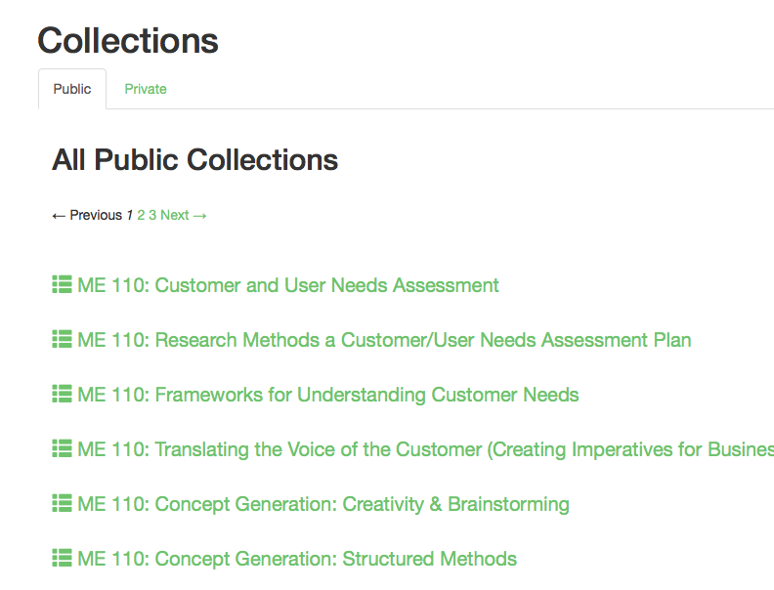
theDesignExchange Content
Methods
Case Studies
Collection
Curated a comprehensive collection of methods, organized to help you navigate the ambiguous nature of design
Our methods are actionable - with best practices, instructions for use, resources, and more to help you seamlessly embed design thinking into your work
Provide a structure to the fuzzy and open-ended human-centered design process
Provide contextual examples of design methods in practice
Support designers address complex challenges through a human-centered design process
Inspire and empower the design community to creatively embed methods in practice
Create your own collections of design methods
Make it either Public or private

Slide 5
Methods are Organized around 5 Modules
theDesignExchange.org
Research
Analyze
Ideate
Build
Communicate
https://www.thedesignexchange.org/
TheDesignExchange is an online educational platform that provides a central repository of early design stage methods, engaging all stakeholders in the design community of practice, and integrating online learning with real case studies to demonstrate the methods.

Slide 6
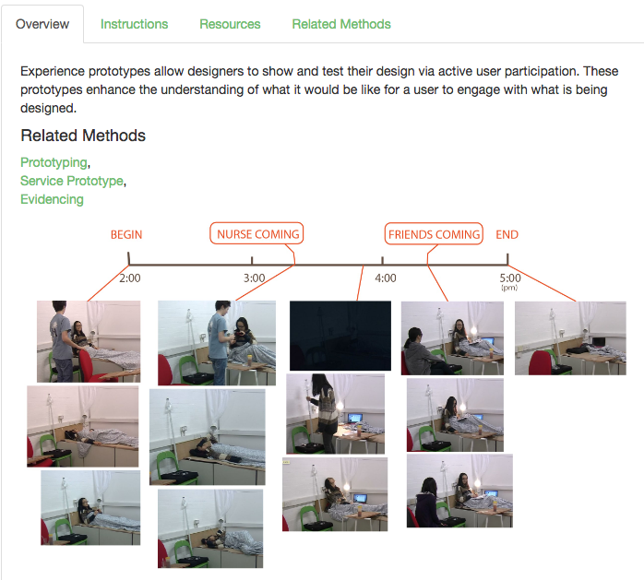
Methods Tabs: Overview, Instructions, Resources
Example: Experience Prototype
Description and image
When to Use
Benefits
Limitations/ Risks
Skills that help
Videos

Slide 7
Collection of HCD Methods in the Design Process
Research (12)
Analyze (16)
Ideate (10)
Build (8)
Communicate (9)
1:1 Interviews
User Observations
AEIOU
POEMS
POSTA
Personas
Closed Card Sorting
Open Card Sorting
Design Ethnography
Community Appraisal
Conversation Café
Competitive Analysis
Why-how Laddering
Empathy Map
Spectrum Mapping
2x2 Matrix
Reframing
Powers of 10
Customer Journey Mapping
Competitive Analysis
How Might We
Mind Map
Contextmapping
Affinity Diagramming
Atomize
Concept Map
Touchpoint Matrix
Kano Analysis
6-Up Sketches
Visual Brainstorming
Brainstorming
3-12-3 Brainstorming
6-3-5 Brainwriting
Attribute Listing
Biomimicry
Weighted Matrix
The Anti-Problem
Borda Count Voting
Prototyping (Rapid)
Laser Cutting
Early Stage Prototyping
Fused Deposition Models
Tangible Prototype
Live Prototyping
Experience Prototype
Service Prototype
Usability Report
Envisionment Videos
Storyboards
Service Blueprint
7 Ps Framework
Personas
Composite Characters
Design Roadmap
Role Play

Slide 8
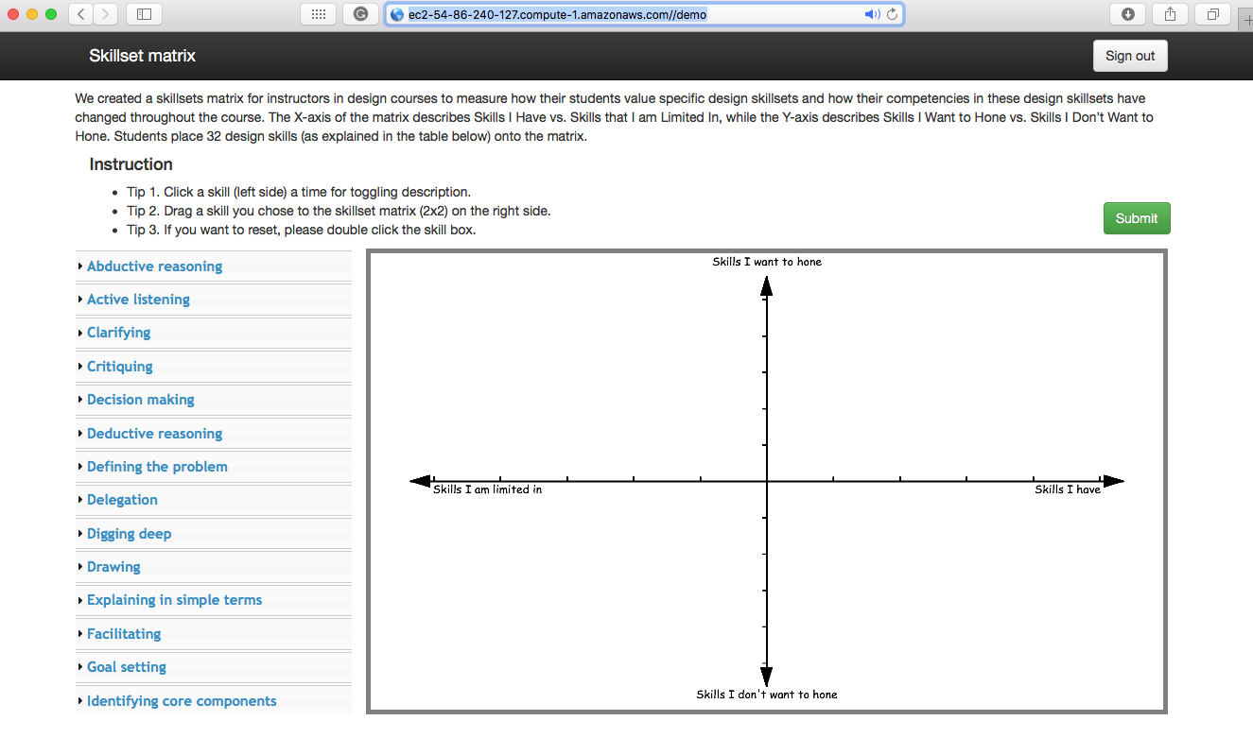
Skillset Matrix (Demo)
http://ec2-54-86-240-127.compute-1.amazonaws.com//demo
32 design skills
Notes:
We have also created a skillsets matrix for instructors in design courses to measure how their students value specific design skillsets and how their competencies in these design skillsets change throughout the course. The X-axis of the matrix asks students to evaluate the strength of the Skills I Have vs. Skills that I am Limited In. The Y-axis asks students to evaluate the strength they have in the Skills I Want to Hone vs. Skills I Don’t Want to Hone. Students place 32 design skills (as explained in the attached table Skills-Descriptions) onto the matrix.

Slide 9
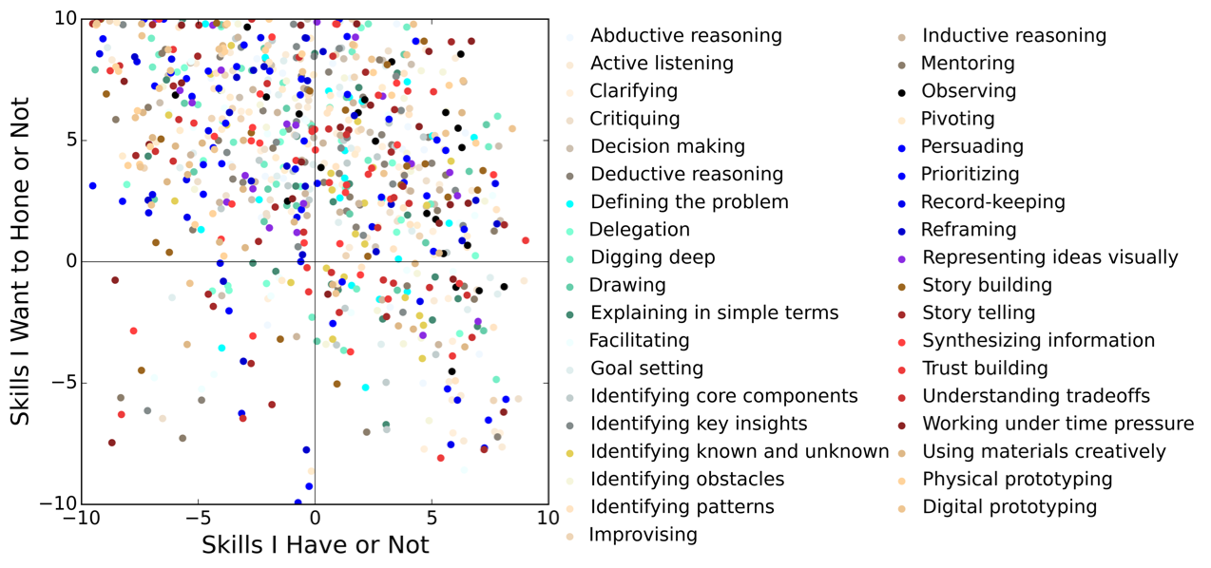
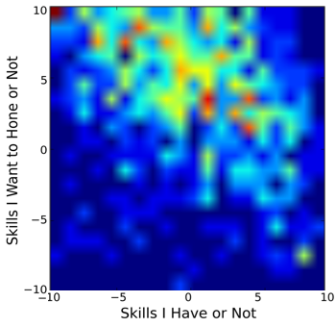
Skillset Matrix (Data Visualization- Pre survey)

Slide 10
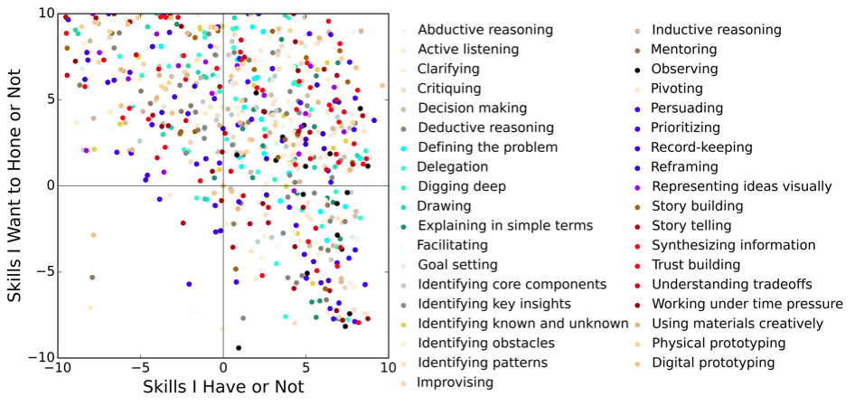
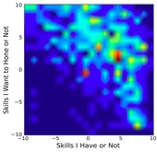
Skillset Matrix (Data Visualization - Post survey)

Slide 11
Discussion
Collaboration between the Design Society and tDX
?

Slide 12
Appendix

Slide 13
How to navigate the tDX website

Slide 14
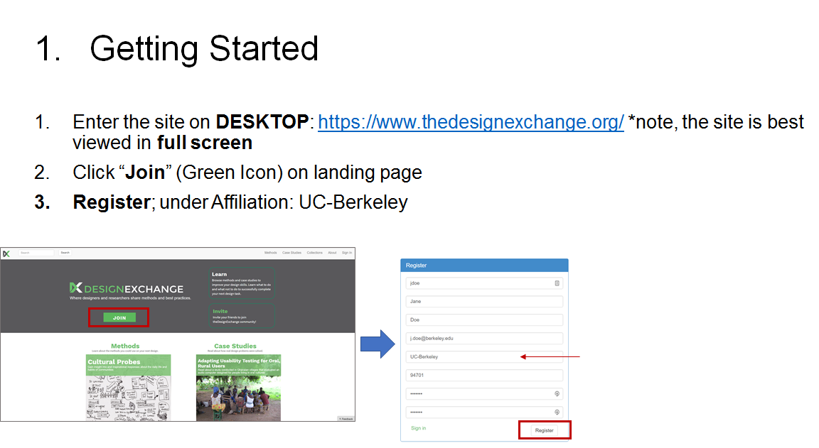

Slide 17
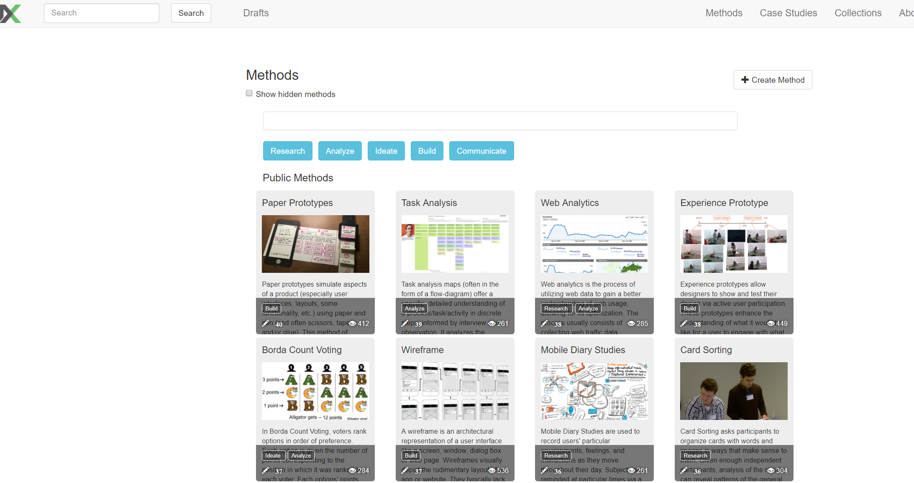

Slide 20
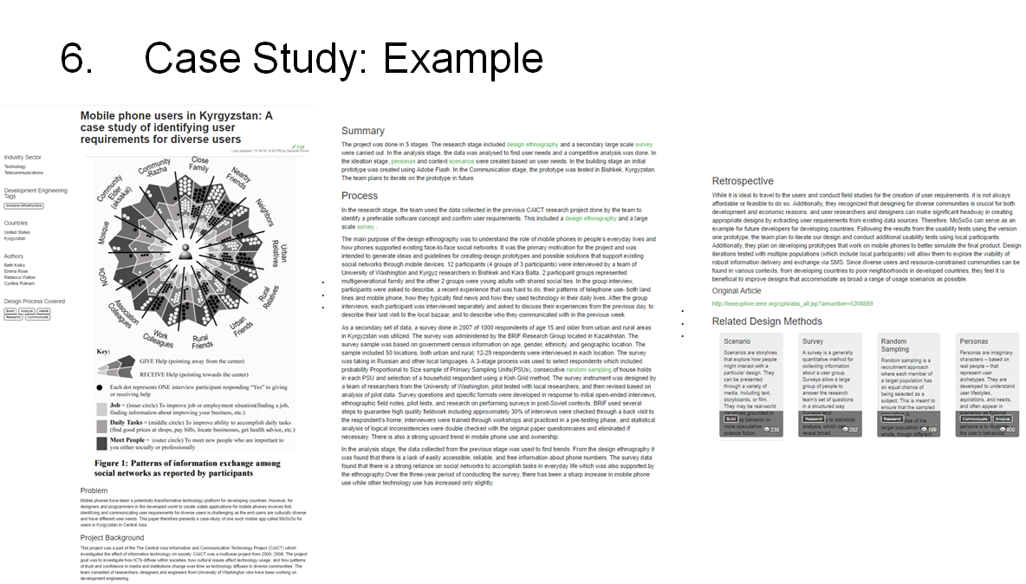

Slide 21
Skillsets Matrix Instruction (Post)
We want to understand how students value specific design skillsets at the beginning/end of the semester. We prepared Skillsets Matrix exercise of 32 basic design skills (See the ones in the left menu on the website provided).
X-axis: Skills I have vs. Skills that I am limited in
Y-axis: Skills I want to horn vs. Skills I don’t want to hone
Please use the Link below
http://tinyurl.com/dx2x2SkillMatrix
Fill out the sign-in form
UID: Your UID (You can find your UID on the website “www.berkeley.edu/directory”)
First Name: Your first name (in the bcourse system)
Survey Key: SU18_FINAL
Notes:
How did the students’ valuation of design competencies change during the course?
2x2 diagram. “Skills I don’t have” vs. “Skills I do have” and “Skills I don’t want to hone more” vs. “Skills I do want to hone more”

Slide 22
How to participate
Step 1. Click a skill (a left side of your screen) line for toggling description.
Step 2. Drag a skill you chose to the skillset matrix (2x2) on the right side where you want to sit it on over the guided scales in the 2x2 matrix.
Step 3. If you want to reset, please double click the skill box.
When you are done (repeat it for all skillsets), then click the “submit” button.
And you are all set!

Slide 23
How to participate
Step 1. Click a skill (a left side of your screen) line for toggling description.
Step 2. Drag a skill you chose to the skillset matrix (2x2) on the right side where you want to sit it on over the guided scales in the 2x2 matrix.
Step 3. If you want to reset, please double click the skill box.
When you are done (repeat it for all skillsets), then click the “submit” button.
And you are all set!

Slide 24
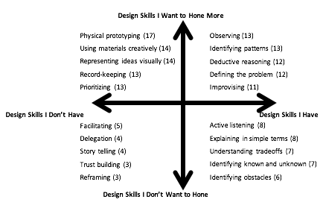
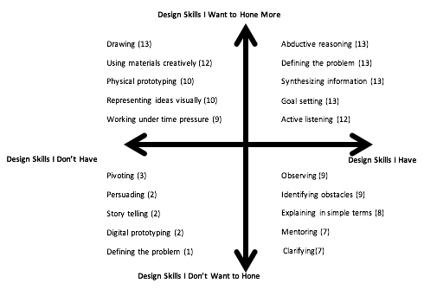
2x2 Skill Set Matrix

Slide 25
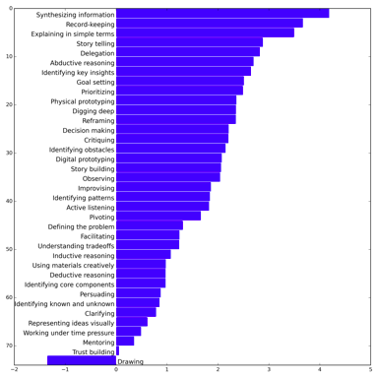
2x2 Skill Set Matrix

Slide 26
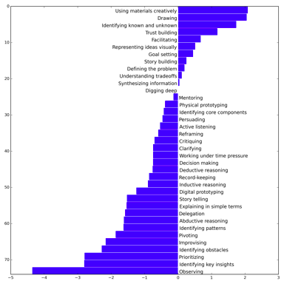
2x2 Skill Set Matrix

